Slide 1
Recommendation System
By
Dr. S PADMANABHAN

Slide 2
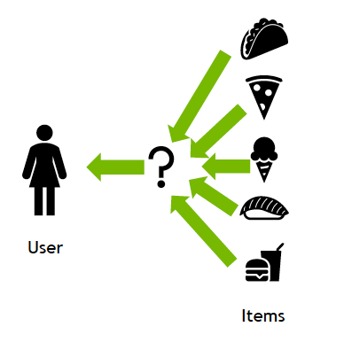

Slide 3
Recommendation System
A recommendation system is an artificial intelligence or AI algorithm, usually associated with machine learning, that uses Big Data to suggest or recommend additional products to consumers.
These can be based on various criteria, including past purchases, search history, demographic information, and other factors.
Recommender systems are highly useful as they help users discover products and services they might otherwise have not found on their own.

Slide 4
Recommendation System
Recommender systems are trained to understand the preferences, previous decisions, and characteristics of people and products using data gathered about their interactions. These include impressions, clicks, likes, and purchases.
Because of their capability to predict consumer interests and desires on a highly personalized level, recommender systems are a favorite with content and product providers.
They can drive consumers to just about any product or service that interests them, from books to videos to health classes to clothing.

Slide 5
Recommendation System Applications
Netflix recommends movies
E-commerce sites recommends item based on our purchase history
Youtube recommends videos
Song recommendations by spotify
Food recommendations by restaurants
Social media sites recommends content
Courses in e-learning
Jobs
Advertising messages

Slide 6
Why Recommendation Systems ?
Increase in sales by personalizing offers
Enhanced customer experience
More time spent on platform
Helps user to find item of their interest
Helps provider to deliver an item to the right user

Slide 7
Types of recommendation system
There are majorly six types of recommender systems which work primarily in the Media and Entertainment industry:
1. Popularity based recommendation system
2. Content-based recommendation system
3. Collaborative recommendation system
4. Matrix factorization recommendation system
5. Association Rule
6. Hybrid-recommendation system

Slide 8
1. Popularity based recommendation system
A popularity-based recommendation system suggests the most popular or frequently purchased items to customers.
This type of system can be useful when there isn't past data to reference, such as when recommending movies to a new user.
Popularity-based systems are simple to implement, fast to train, and only require product information, not customer preference data.

Slide 9
1. Popularity based recommendation system
There are two main types of popularity-based recommender systems:
Most popular across all customers: Recommends the most popular items across all customers
Most popular per customer: Recommends the most popular items for each individual customer
For example, a popularity-based system might suggest a product that's often purchased by new users to a new user who just signed up.

Slide 10
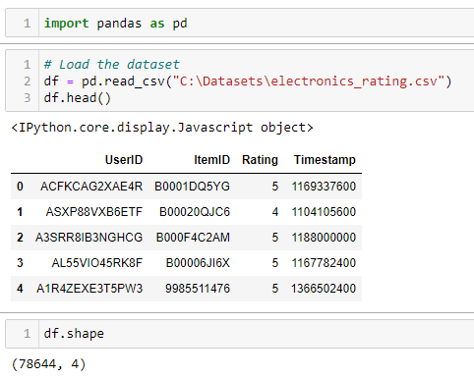
Python code – To Build the popularity based recommendation system and suggest top 5 items. Use the dataset: electronics_rating.csv

Slide 11
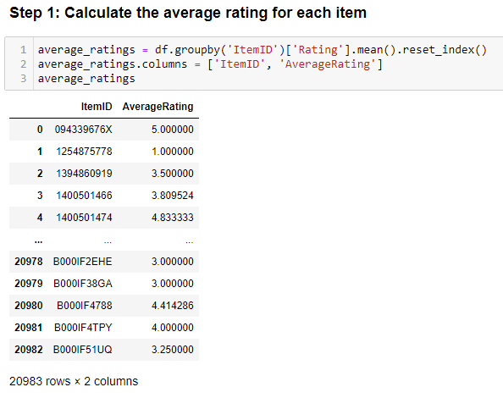

Slide 12
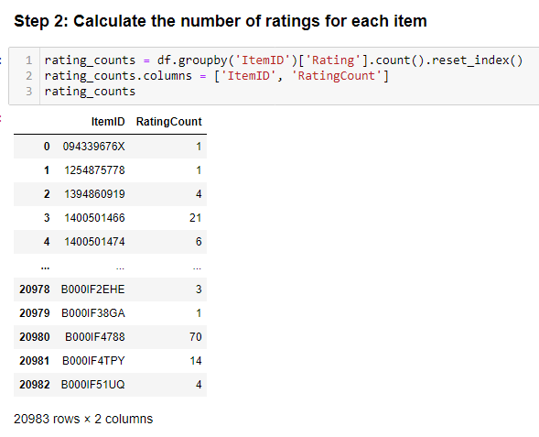

Slide 13
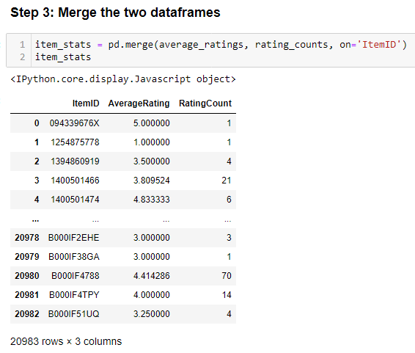

Slide 14
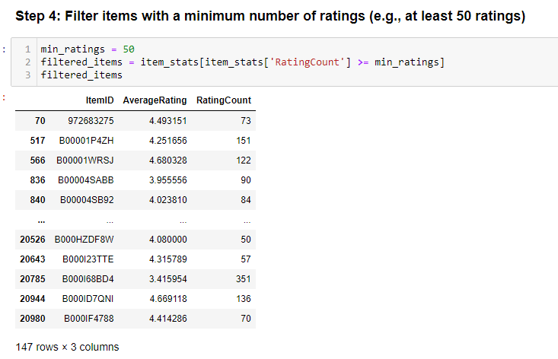

Slide 15
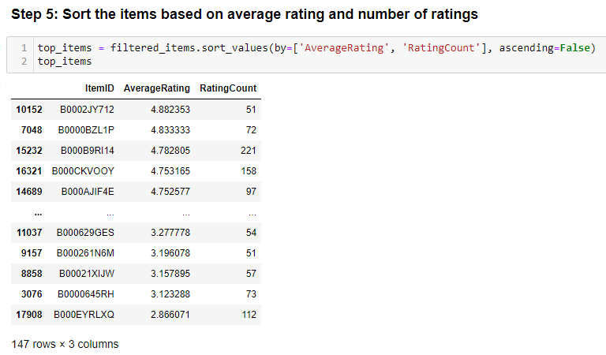

Slide 16
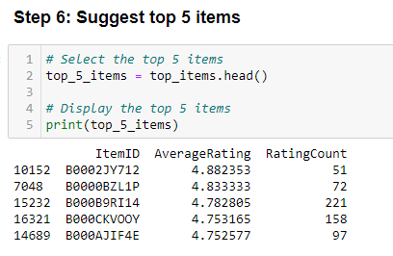

Slide 17
2. Content-based recommendation system
Content filtering, by contrast, uses the attributes or features of an item (this is the content part) to recommend other items similar to the user’s preferences.
This approach is based on similarity of item and user features, given information about a user and items they have interacted with (e.g. a user’s age, the category of a restaurant’s cuisine, the average review for a movie), model the likelihood of a new interaction.
For example, if a content filtering recommender sees you liked the movies You’ve Got Mail and Sleepless in Seattle, it might recommend another movie to you with the same genres and/or cast such as Joe Versus the Volcano.

Slide 18
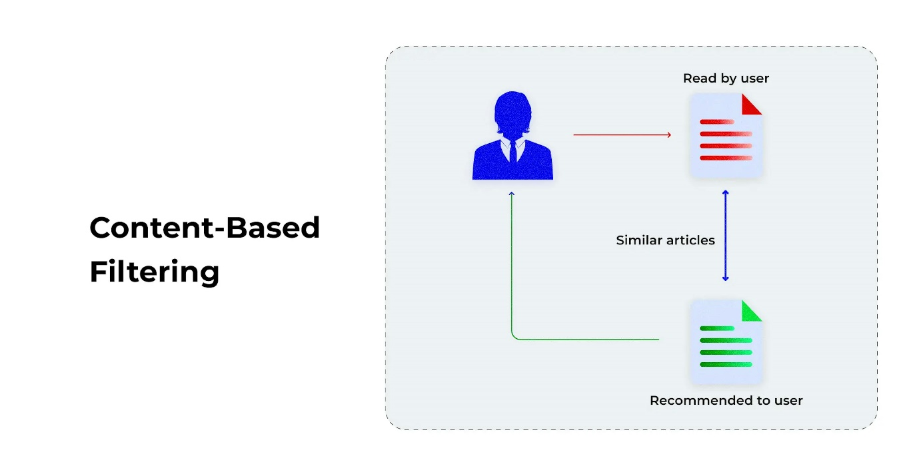

Slide 19
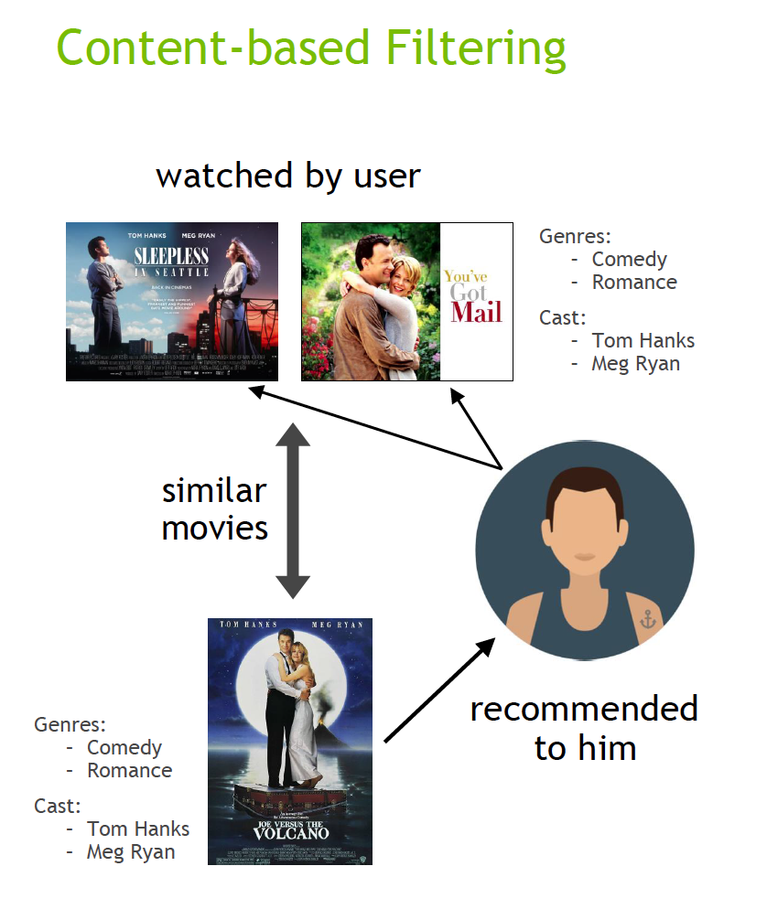

Slide 20
3. Collaborative recommendation system
Collaborative filtering algorithms recommend items (this is the filtering part) based on preference information from many users (this is the collaborative part).
This approach uses similarity of user preference behaviour, given previous interactions between users and items, recommender algorithms learn to predict future interaction.
These recommender systems build a model from a user’s past behaviour, such as items purchased previously or ratings given to those items and similar decisions by other users.

Slide 21
3. Collaborative recommendation system
The idea is that if some people have made similar decisions and purchases in the past, like a movie choice, then there is a high probability they will agree on additional future selections.
For example, if a collaborative filtering recommender knows you and another user share similar tastes in movies, it might recommend a movie to you that it knows this other user already likes.

Slide 22
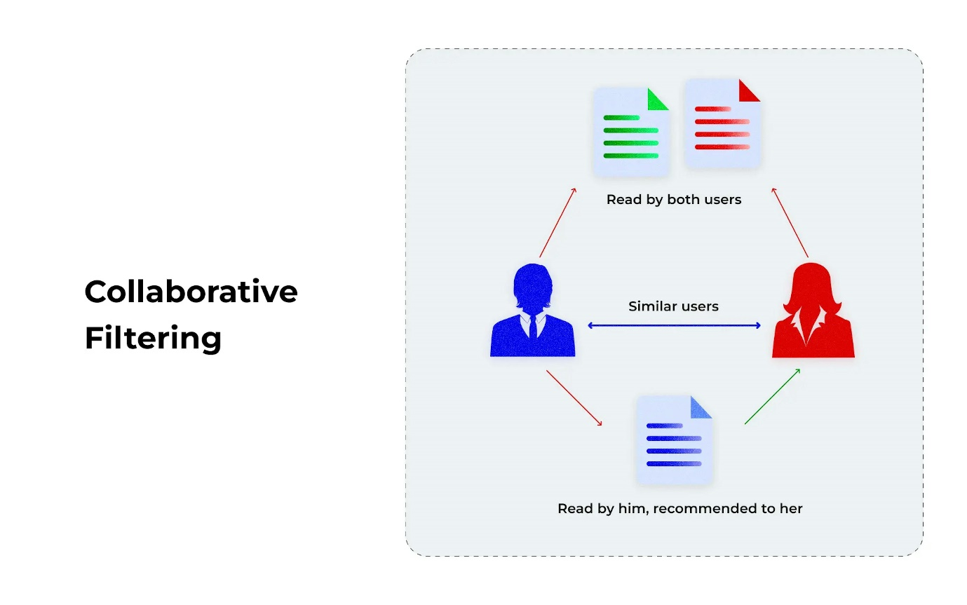

Slide 23
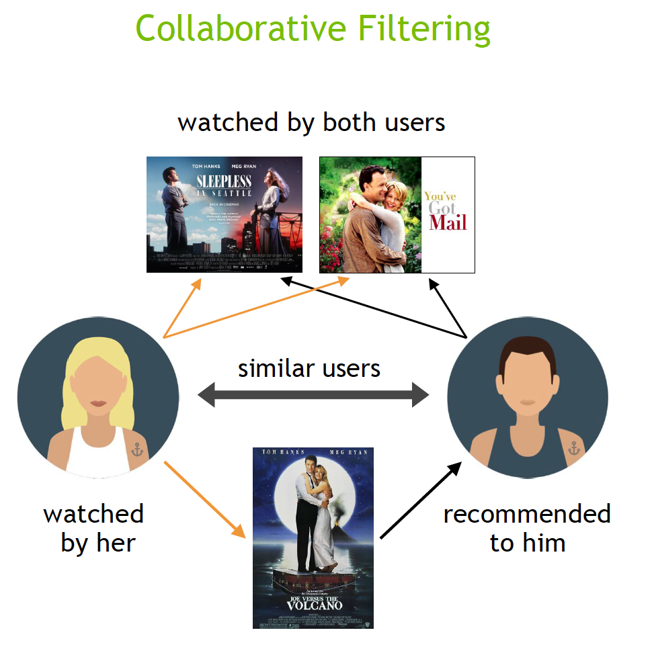

Slide 24
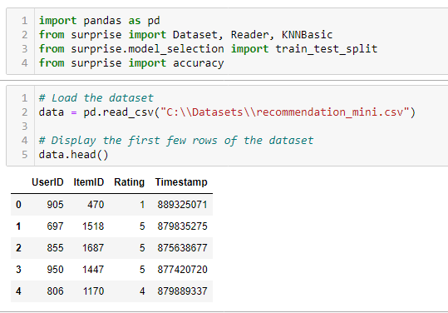
Python code – To Build a recommendation engine using KNN for collaborative filtering.

Slide 25
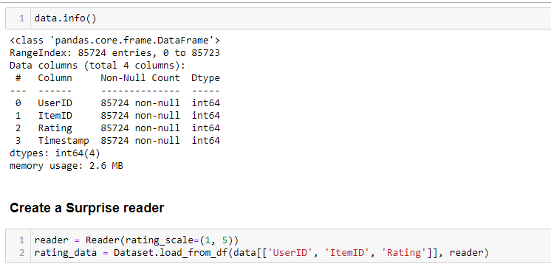

Slide 26
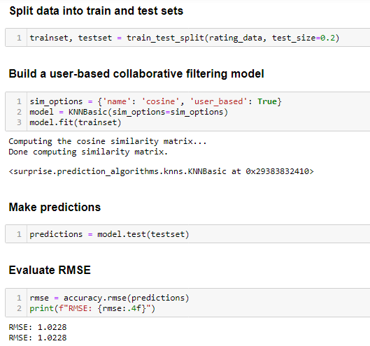

Slide 27
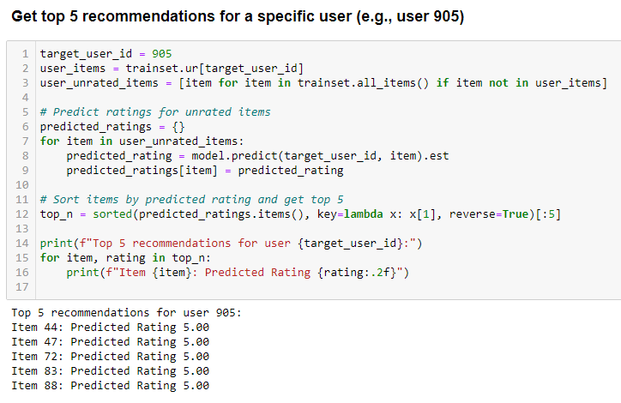

Slide 28
4. Matrix factorization recommendation system
A Matrix Factorization Recommendation System is a popular method in collaborative filtering used to provide personalized recommendations.
It works by decomposing the user-item interaction matrix into the product of two lower-dimensional matrices, capturing latent factors for users and items.

Slide 29
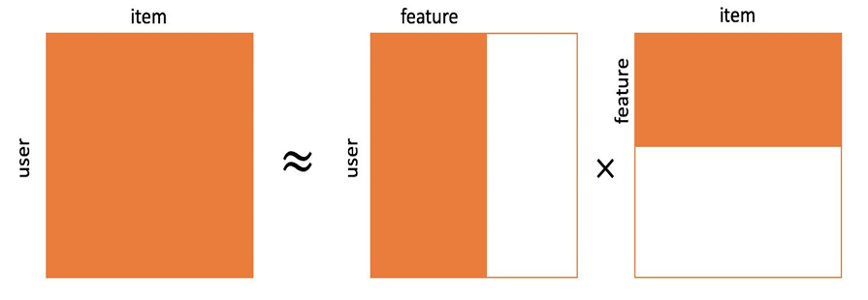
4. Matrix factorization recommendation system

Slide 30
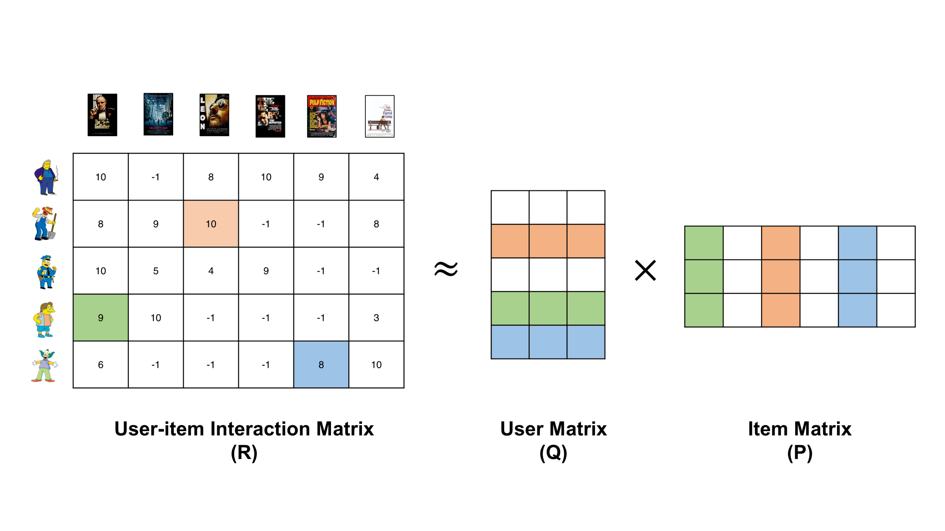
4. Matrix factorization recommendation system

Slide 31

A recommender system has two entities — users and items.
Let’s say we have m users and n items.
The goal of our recommendation system is to build an m x n matrix (called the utility matrix) which consists of the rating (or preference) for each user-item pair.
Initially, this matrix is usually very sparse because we only have ratings for a limited number of user-item pairs.
The matrix is populated by decomposing (or factorizing) the Utility matrix into two tall and skinny matrices. The decomposition has the equation:
where U is m x k and V is n x k.

Slide 32

U is a representation of users in some low dimensional space, and V is a representation of items.
For a user i, uᵢ gives the representation of that user, and for an item e, vₑ gives the representation of that item.
The rating prediction for a user-item pair is simply:
Rating prediction for a user-item pair is simply the dot product of the user and item representations

Slide 33
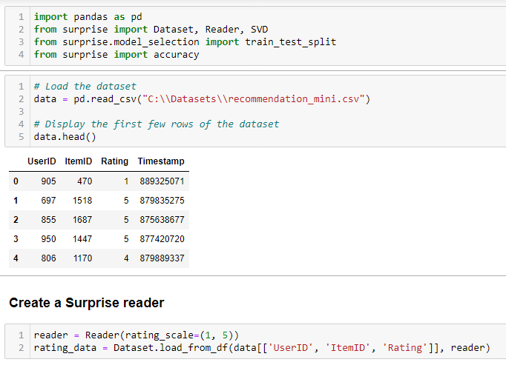
Python code – To Build a recommendation engine using SVD for collaborative filtering.

Slide 34
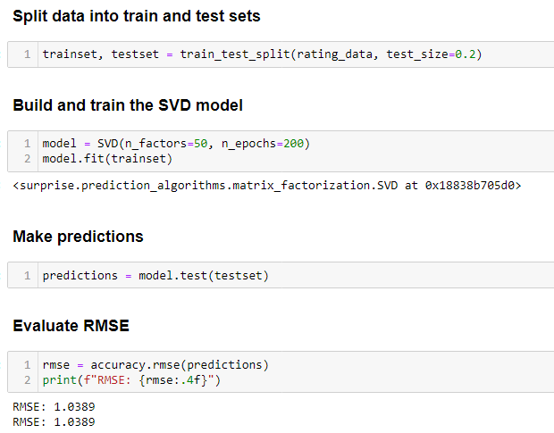

Slide 35
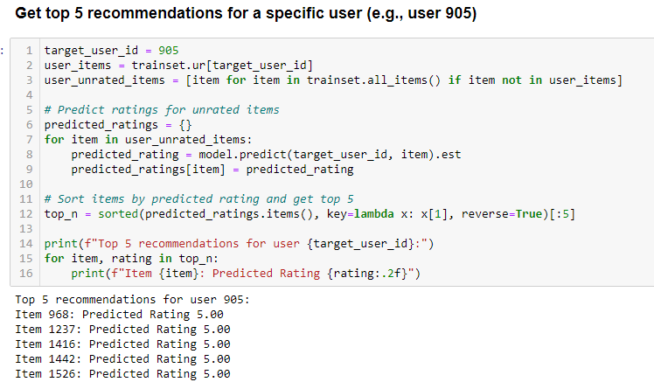

Slide 36
Applications
Movie recommendations: Predict how much a user would like a movie they haven’t rated yet.
Music recommendations: Suggest songs based on the user's listening history.
Product recommendations: Suggest items on an e-commerce platform.

